Slide 1
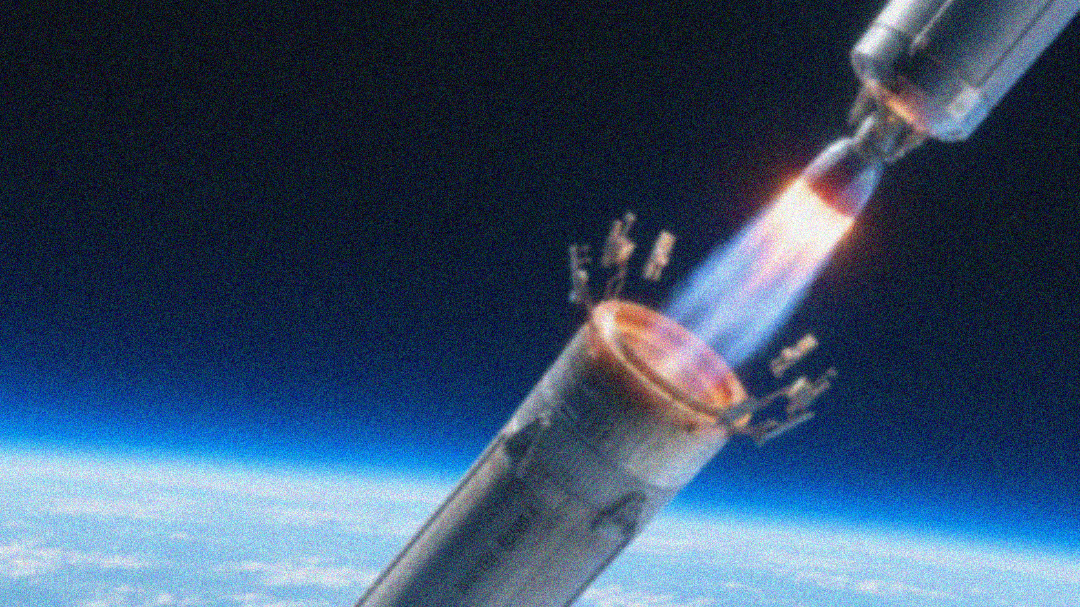
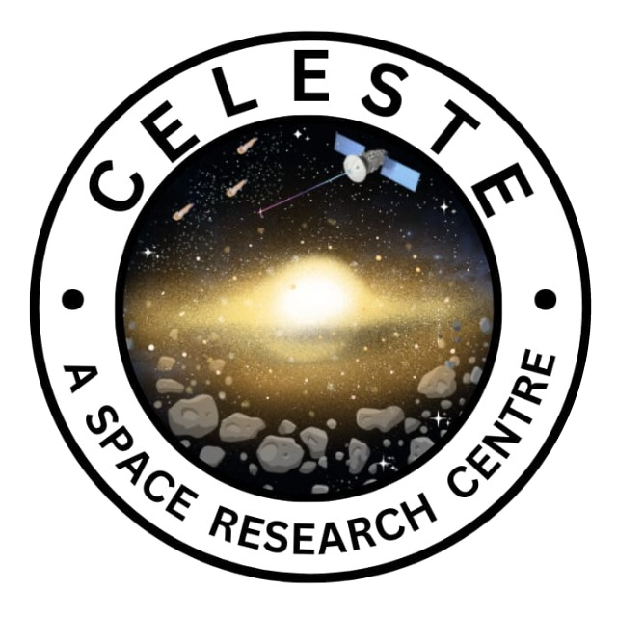

ORIGIN
A CELESTE RESEARCH SPRINT
TEAM NUMBER : 4
TEAM MEMBERS : Kaustubha Kodandapani (449) Anwitha Koneru (499)
Chennuru Neelotpala (4A4)
Gongalla Sloka Reddy (4A9)
THEME : Rocketry & Future Space Transportation
RESEARCH PAPER TITLE : Navigating the Future of Space Exploration: An Overview of Reusable Launch Vehicles
ORIGIN · A CELESTE RESEARCH SPRINT

Slide 2
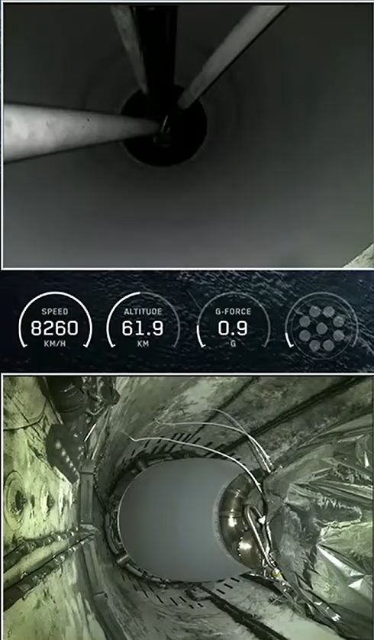

SpaceX's Falcon 9 stage separation
Basic RLV Operation:
Launch & Ascent to Orbit
Stage Separation
Orientation Flip
Boostback Burn
Atmospheric Re-entry Burn
Grid Fins Deployment

Slide 3
01
OBJECTIVES / PURPOSE OF THE PAPER
ORIGIN · A CELESTE RESEARCH SPRINT

Slide 4
Traditional rockets fly once and are discarded, making space access extremely costly, this paper examines whether reuse can change that.
This study provides a structured overview of reusable launch vehicles (RLVs), integrating technological, economic, and environmental perspectives based on a narrative review of 23 studies published between 2016 and 2024.
Its core purpose is to map what is already proven, what is economically promising, and what remains unsustainable.
By comparing from these 23 studies, the paper exposes where research is strong and where gaps remain.
These identified gaps are meant to guide future RLV research and development.

Slide 5
BACKGROUND & KEY CONCEPTS
02
ELV vs RLV: traditional rockets launch once and are discarded → expensive, unsustainable;
RLVs are reused for cost-efficient, higher-frequency access to space .
Propulsion: staged-combustion engines, throttle capability, cleaner fuels (liquid methane)
Merlin engines need minimal refurbishment.
Thermal Protection (TPS): re-entry heats reach ~1,500°C.
Reinforced carbon–carbon composites & ultra-high-temperature ceramics.
GNC: autonomous guidance for precise vertical landing using real-time data
MRO & turnaround: modular design + predictive maintenance to speed reflight
Space-as-a-Service: rideshare models replacing bespoke missions
ORIGIN · A CELESTE RESEARCH SPRINT

Slide 6

03
METHODOLOGY / APPROACH
ORIGIN · A CELESTE RESEARCH SPRINT

Slide 7
This study uses a narrative literature review approach.
Literature for this review was selected according to four criteria :
      Must substantively address reusable rocketry (tech / economics / environment / policy)
      Published 2016–2024 only, peer-reviewed work prioritized (journals, conferences, theses)
      Sources accessible via academic databases & institutional subscriptions
      Papers grouped into 3 analytical clusters by primary focus (technology / economics /sustainability)
This study uses a narrative literature review approach.
Literature for this review was selected according to four criteria :
      Must substantively address reusable rocketry (tech / economics / environment / policy)
      Published 2016–2024 only; peer-reviewed work prioritized (journals, conferences, theses)
      Published 2016–2024 only; peer-reviewed work prioritized (journals, conferences, theses)
      Sources accessible via academic databases & institutional subscriptions

Slide 8
04
RESULTS / EVIDENCE / OBSERVATIONS
How the evidence is organized — The 23 reviewed studies fall into three clusters: technology (12 papers, ~52%), economics (6 paper, ~26%), and environment/sustainability (5 papers, ~22%) — showing research attention is uneven.
ORIGIN · A CELESTE RESEARCH SPRINT

Slide 9
TECHNOLOGICAL DEVELOPMENT
Over 50% of the surveyed literature i.e. 12 out of 23 papers represents technological development
Mainly focusing on :
Propulsion Systems
Engines
Thermal Protection Systems
Maintenance, Repair and Overhaul (MRO)
Guidance, Navigation and Control (GNC)

Slide 10
TECHNOLOGICAL DEVELOPMENT
PROPULSION SYSTEMS :
They focus on staged combustion cycles ,throttle and using clearer liquid methane which allow multiple burns with minimal refurbishment
ENGINE :
SpaceX's ninth starship test flight reused one of its raptor engins three times until the vehicle stopped working
THERMAL PROTECTION SYSTEMS :
Usage of high temperature ceramics which can withstand heat

Slide 11
TECHNOLOGICAL DEVELOPMENT
MRO :
Turnaround time is decreased by using modular systems and sensor data is used for predictive maintenance
GNC :
AI and ML are used for accurate trajectory calculations and precise landing of reusable rockets

Slide 12
ECONOMICS FEASIBILITY
Cost falls with every flight : One rocket's cost is shared across many flights, so per-launch cost keeps falling Falcon 9's recovered boosters show this in action.
The barrier to entry is huge : Building a reusable system demands massive upfront investment before a single saving appears.
Savings depend on demand : works only if there is sufficient flight rate and reliability, a booster flown rarely, or lost to failure, erases the advantage.
Business models remain unproven : Concepts like "Space as a Service" are promising, but the reviewed studies show the economics of RLV business models is understudied, making it a key research gap .

Slide 13
ENVIRONMENTAL SUSTAINABLITY
Waste vs. Emissions Trade-off: Reuse cuts manufacturing waste, but cheaper launches mean higher flight frequency → more in-flight emissions at altitude, where they persist longer. Which effect dominates remains unquantified.
Orbital Debris & Collision Risk: Rising launch rates + growing satellite constellations increase debris risk. Mitigation (deorbiting, graveyard orbits) exists but is inconsistently enforced.
Regulation Gap: Environmental and debris issues cross borders; existing frameworks (e.g., UN guidelines) lag behind the pace of industry growth. Stronger international coordination needed.

Slide 14
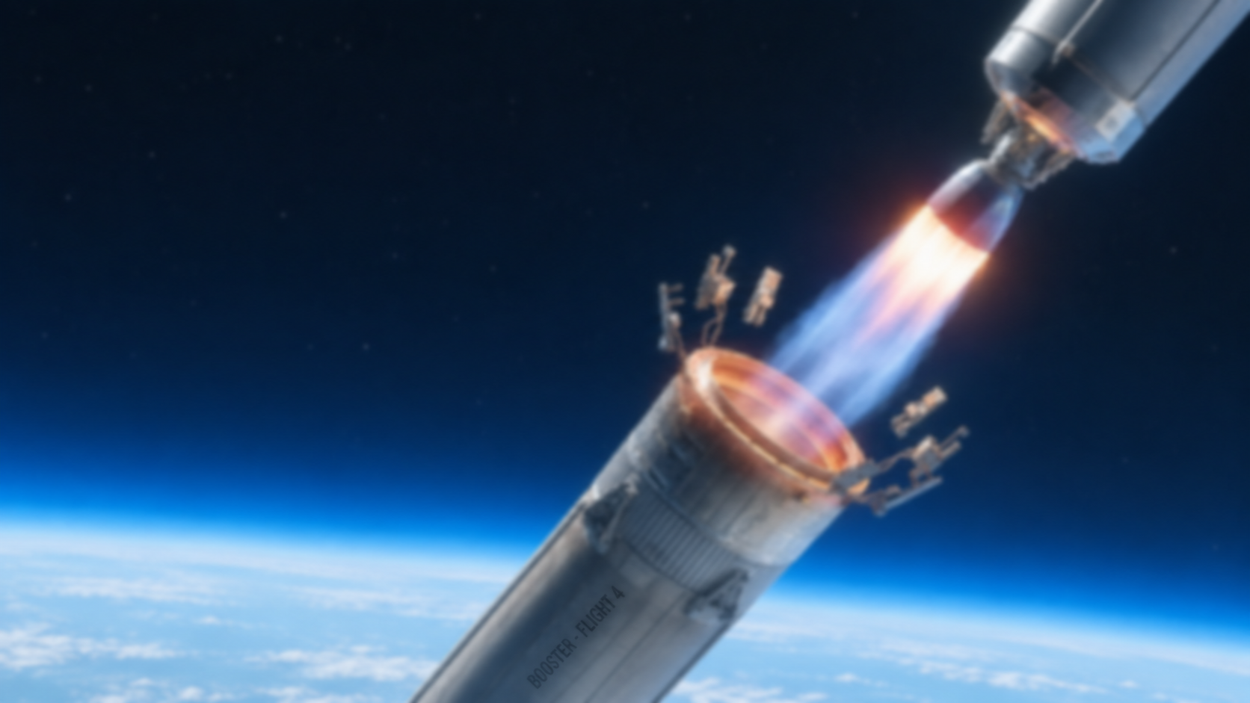
05
OUR TAKEAWAY AND CONCLUSIONS
ORIGIN · A CELESTE RESEARCH SPRINT

Slide 15
Technology: Progress in propulsion, thermal protection, materials, MRO, and GNC shows re-flight is now a demonstrated reality in operational launch systems
Re-flight is proven, not yet routine: Cost-effective re-flight demands the right combination of vehicle durability, rapid refurbishment, and high launch cadence these must advance together for reuse to deliver its full benefits
Economics: costs fall, access widens : Spreading fixed costs across flights and models like Space-as-a-Service are lowering per launch costs and opening space to more commercial, governmental, and emerging actors though high upfront investment and entry barriers persist.
Sustainability & policy: the next frontier Reuse cuts manufacturing waste, but rising launch rates increase in-flight emissions and pressure on the orbital environment — demanding robust regulation, end-of-life disposal practices, and international (not purely national) governance frameworks

Slide 16
06
APPLICATIONS AND FUTURE SCOPE
ORIGIN · A CELESTE RESEARCH SPRINT

Slide 17
Technical refinement: engines, thermal protection, predictive maintenance: Future work must focus on refining these systems to support high-cadence, reliable RLV operations at scale, closing the gap between current capability and full operational reliability.
AI/ML: promising, not yet proven: Real-time guidance, fault detection, and predictive maintenance via machine learning are suggested as a way to close the reliability gap, though these approaches haven't yet fully resolved the underlying engineering challenges.
Policy & sustainability: the next frontier : Growing emissions and orbital debris demand stronger international coordination on environmental standards, space traffic management, and end-of-life protocols — risks no single country can manage alone.
Narrower future reviews, deeper analysis : Rather than covering technology, economics, and environment broadly together, future reviews should focus on a single dimension — propulsion, MRO processes, or launch-cost modeling — to allow far deeper technical and quantitative analysis.

Slide 18
Global Trends as of 2026:
Full reusability nearing reality : Starship is pushing toward recovering both booster and upper stage, targeting up to 100 tons to orbit; leading companies are targeting 24-hour turnarounds, treating rockets like aircraft to meet demand from mega-constellations like Starlink.
Blue Origin entering the race : New Glenn is Blue Origin's answer to Falcon 9, using vertical takeoff and vertical landing (VTVL) with reusable boosters, marking serious competition to SpaceX's dominance in the reusable heavy-lift segment.
China's LandSpace advancing : Zhuque-3 is China's vertical-landing reusable booster, signaling that reusability is no longer a US-exclusive capability and that China is actively catching up in commercial reusable launch technology.
Vertical integration : Alongside this competition, companies are shifting toward in-house 3D printing and modular designs to make maintenance of reusable parts faster and cheaper.

Slide 19
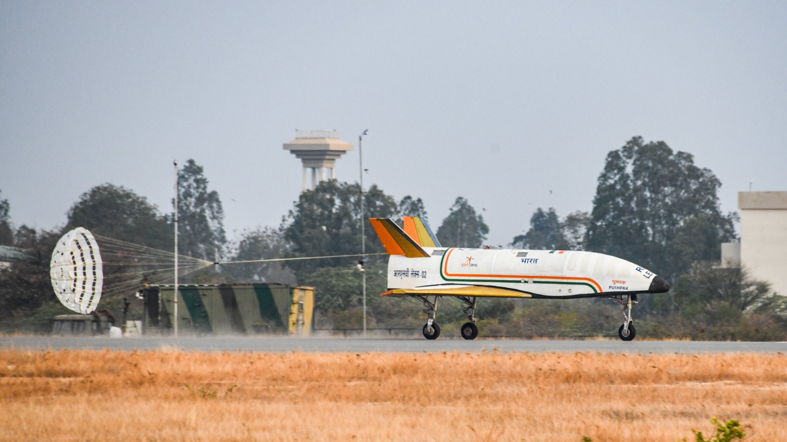
PUSHPAK:
Completed all three Landing Experiments (LEX-01 to LEX-03, 2023–2024) — autonomous runway landing under severe wind conditions, with reused flight hardware across tests.
Pushpak launches to orbit, then re-enters and lands autonomously from real orbital velocity, validating guidance and thermal protection under true space-return conditions.
Future testing: precise land and sea landings, similar to SpaceX's Falcon 9 recoveries.
ISRO is working with national and international research institutions, with ongoing innovation in propulsion, thermal protection, and avionics remaining central to the program's success.

